Slide 1
Artificial Neural Network
Applied Mathematics
Shay Malkin
Tal Ladijensky
Nir Titelbom

Slide 2
Contents
Introduction
ANN Applications
Perceptron
Feedforward Neural Network
Activation Functions
Cost Function
Gradient Descent
Stochastic Gradient Descent
Back Propagation
Convolutional Neural Network
Recurrent Neural Networks
Autoencoder
ANN Advantages

Slide 3
Introduction
An ANN is a mathematical model for computation inspired by the structure of a biological neural network (the brain). The model is able to "learn" to perform tasks from given examples (training data), without being "hard coded" with specific instructions. This approach enables us to solve complex problems that otherwise would be impossible to solve (with direct instructions).k
A good example is an image classifier, i.e. a model that, given an image from a pool of a finite number of categories (dogs, cats, cars, etc.), classifies the image to its correct category.y

Slide 4
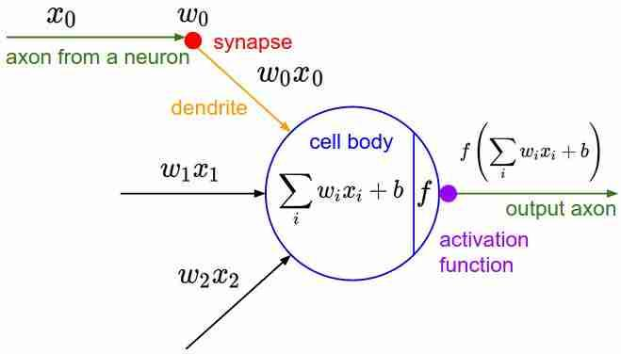
The model learns to perform that task by being given a large set of images labeled with their correct category, then allowed to predict their labels (at first, completely arbitrary). Then, we compare the predictions with the correct results and calculate the cost function. That means, how much the prediction was wrong. Via an optimization process (more on that later) we gradually minimize the cost function.

Slide 5
ANN Applications
Artificial neural networks can help solve many problems such as:s
➢ Pattern classification
➢ Categorizations
➢ Function approximation
➢ Forecasting
➢ Optimization
➢ Content - addressable memory
➢ Control on the inputs and the outputs
We can see artificial neural networks today at many fields like face recognition, character recognition, capital market prediction, text analysis etc.

Slide 6
Perceptron
The Perceptron was introduced by Frank Rosenblatt in 1957. The idea of the Perceptron is to be a type of linear classifier. The Perceptron gets a combination of a feature vector and a set of weights , sums them up and passes the sum forward to produce an output. The Perceptron is a single layer neural network often referred to as a neuron. This artificial neuron is based on our biological neuron. In the 1950s, the perceptron became the first model that can learn the weights and can define categories of a given examples of inputs from each category. A multi-layer perceptron is called Neural Networks and it is a mathematical function mapping a set of input values to output values. We can think of each application of a different mathematical function as providing a new representation of the input.

Slide 7
The usage of the idea of the Perceptron is for an algorithm for supervised learning of binary classifiers. This algorithm enables them to study and understand elements in the test data one at a time. How this algorithm works? Well, each neuron holds an internal state called activation signal. Each neuron is connected to another neuron via connection link. We use a function that maps its input X, which is multiplied with the learned bias and weights respectively and an output f(x) is generated.

Slide 8
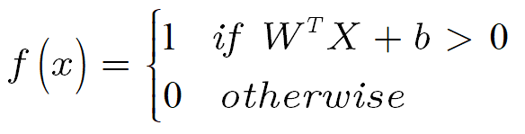
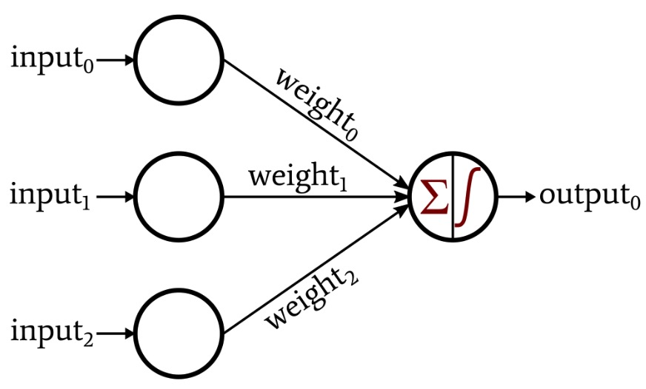
The parameters of the function consist of the learned bias and weights. The bias b is a real number and W is a vector with same size as the inputs. X is a vector of the input n variables. For a given input X, the output is either a ‘1’ or a ‘0’.

Slide 9
What can we do in the case of an error in the output for a given example? The error is propagated backward to allow weight adjustment to happen.
To sum up, a perceptron is a mathematical model of the behavior of a single neuron in a biological nervous system. A single neuron can solve some very simple learning tasks, but the power of neural networks comes when many of them are connected in a network architecture. The architecture of an artificial neural network refers to the number of neurons and the connections between them.

Slide 10
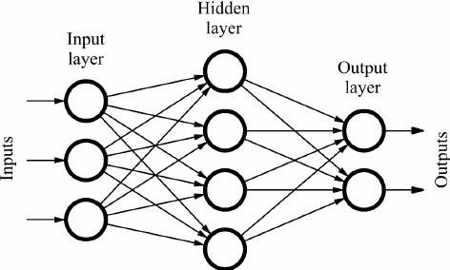
Feedforward Neural Network
A feedforward neural network is an artificial neural network where the nodes do not form a cycle. It is a directed acyclic graph. It is the first and simplest type of neural network devised, where the information moves in only one direction, from the input nodes, through the hidden nodes (if they exist), to the output nodes.
The simplest kind of neural network is a single layer perceptron network, which consist of a single layer of output nodes. This network is only capable of learning linearly separable patterns.
A more complex network would be a multilayer perceptron network. It has at least one hidden layer and it can distinguish data that is not linearly separable.

Slide 11
Activation Functions
Activation functions are an extremely important feature of the artificial neural networks. They basically decide whether a neuron should be activated or not. Whether the information that the neuron is receiving is relevant for the given information. The activation function is often a nonlinear transformation that we do over the input signal. This transformed output is then sent to the next layer as input. When we do not have the activation function the weights and bias would simply do a linear transformation.
We would want our neural networks to work on complicated tasks like language translations and image classifications. Without the differentiable nonlinear function, this would not be possible.

Slide 12
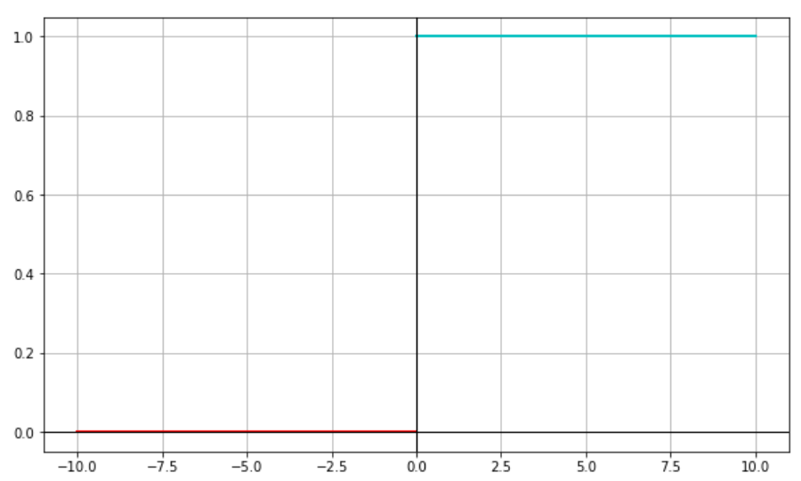

Types of Activation Functions
Binary Step Function:
The binary function is extremely simple. It can be used while creating a binary classifier. When we need to say yes or no for a single class, step function would be the best choice, as it would either activate the neuron or leave it to zero.
Here we define the function as:

Slide 13
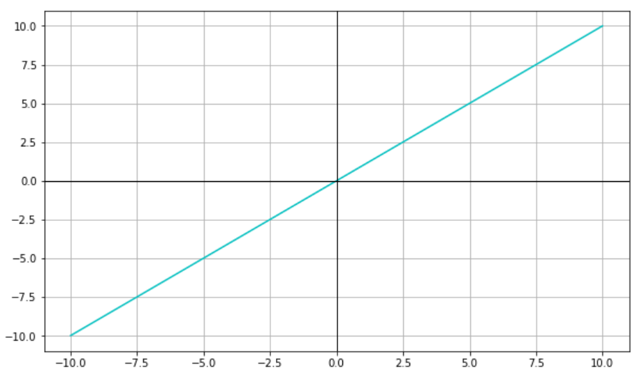

Linear Function:
Here the activation is proportional to the input. The input x, will be transformed to ax. This can be applied to various neurons and multiple neurons can be activated at the same time.
Here we define the function as:

Slide 14
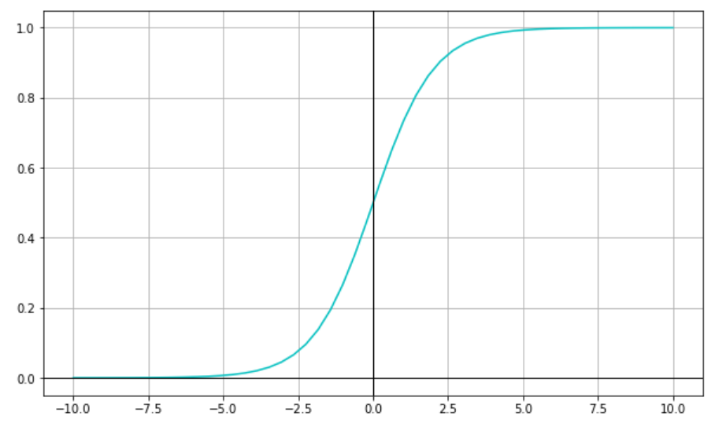

Sigmoid:
This is a smooth function and is continuously differentiable. The biggest advantage that it has over step and linear function is that it is nonlinear. That's means that when we have multiple neurons having sigmoid function as their activation function, the output is nonlinear as well. The function ranges from 0-1.
Here we define the function as:

Slide 15
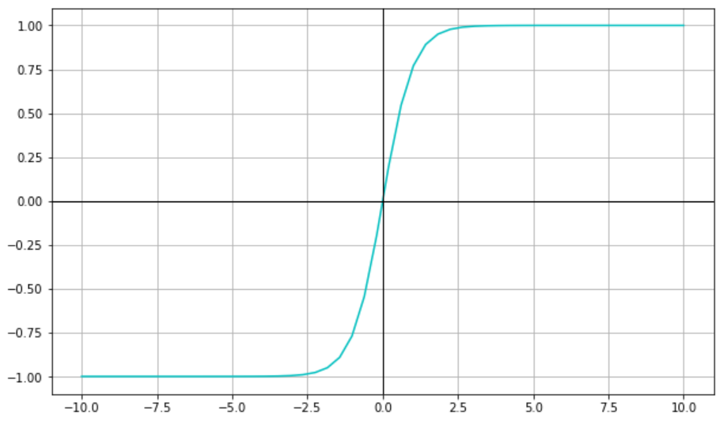

Hyperbolic tangent:
The tanh function is very similar to the sigmoid function. It is actually just a scaled version of the sigmoid function. Tanh works similar to the sigmoid function but is symmetric over the origin. it ranges from -1 to 1.It basically solves the problem of the values all being of the same sign.
Here we define the function as:

Slide 16
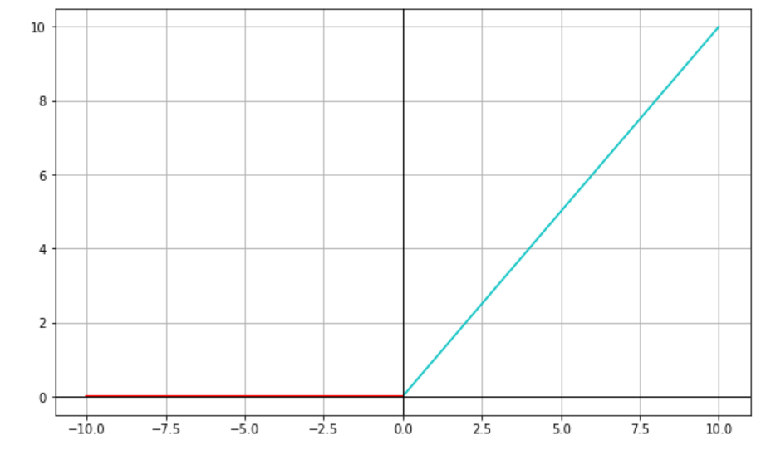

ReLU:
ReLU is the most widely used activation function. The ReLU function is nonlinear, which means we can easily backpropagate the errors and have multiple layers of neurons being If the input is negative it will convert it to zero and the neuron does not get activated. This means that at a time only a few neurons are activated making the network sparse making it efficient and easy for computation.
Here we define the function as:

Slide 17
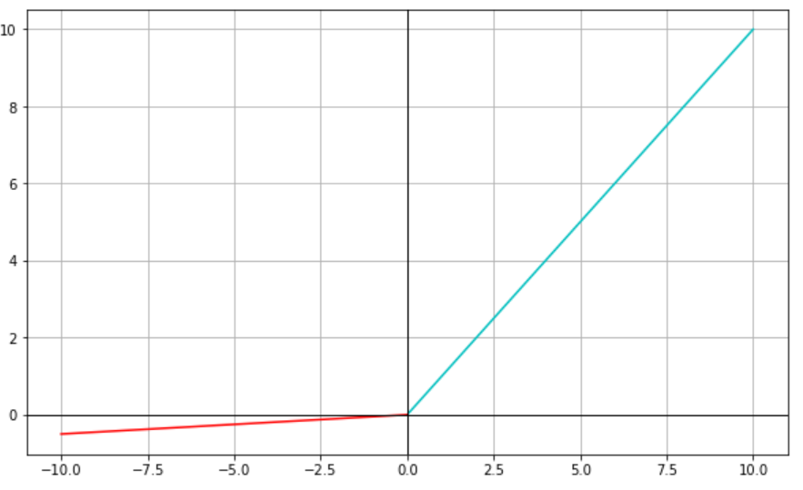

Leaky ReLU:
Leaky ReLU function is an improved version of the ReLU function. Instead of defining the Relu function as 0 for x less than zero, we define it as a small linear component of x (The parameter a is small).
Here we define the function as:
Note:
There is Parameterized ReLU function. It is defined similar to the Leaky ReLU. However, in this case, the network also learns the value of ‘a‘ for faster and more optimum convergence.

Slide 18
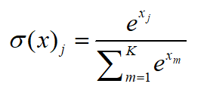
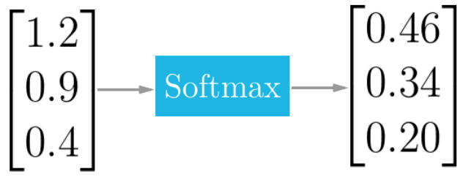

Example
Softmax:
This is an activation function which convert the input to the neuron in the range of 0 and 1 in such a way that the total sum of the outputs is equal to 1. This function is mostly used where we have to define the multi class classification where it gives the output in the form of the probability of occurrence of a class. It is mostly used in the final layer of the neural network.
Here we define the function as:
where:

Slide 19


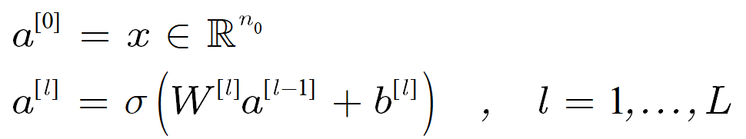




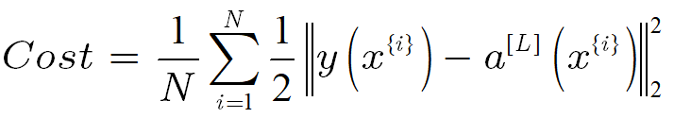
Cost Function
During the training process, we give the model initial weights randomly and try to make him bring us a good prediction on the training set. Cost function calculates how much wrong the model was in his output, by calculating the distance-based error. For example, given an input and let denote the output from neuron j at layer l. Accordingly, we define:e
Now suppose we have N pieces of data (training points) in , ,for which there are given target outputs in . The quadratic cost function is:s

Slide 20


Gradient Descent
Gradient Descent is an iterative optimization algorithm for finding the minimum of a function. Our goal is to minimize the cost function. We will denote a superscript * to symbol the value that minimizes the function. For example .
In this method , we take steps in the opposite direction to the gradient of the function at a given point. The method works like that if we wish to get to the minimum point, we would want to ‘go down’, at every step, in the direction with the steepest descent, which is opposite to the gradient. It resembles to the fact that if we wish to go down from a high place we look for the steepest slope.
Where p is the input value and η is the step size.

Slide 21
Stochastic Gradient Descent
Another version of Gradient Descent that is based on stochastic evaluation. The word ‘Stochastic’ means a system or a process that is linked with a random probability. Hence, in SGD we randomly select one data point from our training set in each iteration in order to reduce the computations in total. Our goal is to complete the network’s task in the most efficient way possible. Hence, we want to minimize the cost function. SGD is typically noisier than other ways of Gradient Descent, and it usually takes a higher number of iterations to reach the desired minimum. That is because of the random picking of the training data. But, it is less expensive than a typical Gradient Descent. That’s why in most cases SGD is preferable over other methods.

Slide 22



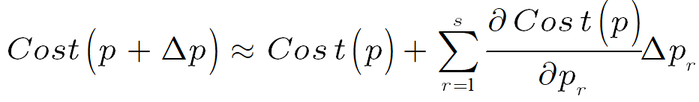


SGD
We denote where s is a total of all weights and biases. As we said, the goal is to minimize the cost function. We will define our cost function to be: In order to find the minimum or in our case . We will expand the cost function in to a first order Taylor Series expansion:
We will denote to be the vector of partial derivatives:

Slide 23



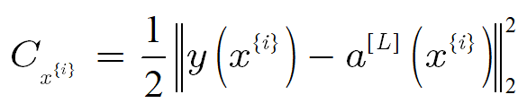

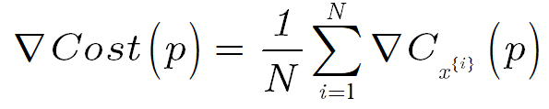
We want to choose to lie in our desired direction .
This leads us to where η is our learning rate (our step size in the gradient descent). Our goal is to iterate until we meet our desired criterion. Now we let: Where denotes the output at the output level. Then, we can write:
Instead of computing the vector at every iteration, a cheaper method is to replace the mean of the individual gradients over all training points by the gradient at a single randomly chosen training point.

Slide 24


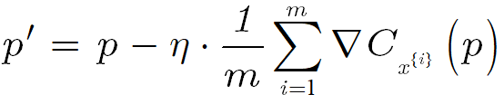
SGD algorithm
The algorithm is simple and it is as follows: For each iteration randomly choose an integer from {1,2,3,....,N} where each number represent a different training point in the training set and updating p by the formula we presented in Gradient Descent slide: Note:
There is a similar method that For m<<N we choose m integers, , uniformly at random from {1,2,…,N} and update as follow:

Slide 25
Stochastic Gradient Descent VS. Gradient Descent
In GD we have to go over all of our training data to do a single update for a parameter in every change to P. On the other hand in SGD we use just a single training point in every change to P. Hence , if we have a large data set then using GD can be expensive in every iteration when we have to update P because we will have to run through all the samples in our set. That’s why SGD will be faster because we use only one training point and it starts improving itself right away from the first point. Although the faster conversion SGD won’t minimize the cost function as well as GD but the parameters will be close enough and eventually will reach our criterion goal values and remain in the surrounding area.

Slide 26
Backpropagation
A neural network propagates the signal of the input data forward through its parameters towards the moment of decision, and then back-propagates information about the error, in reverse through the network, so that it can change the parameters. Backpropagation takes the error associated with a wrong guess by a neural network, and uses that error to adjust the neural network’s parameters in the direction of less error.
A neural network has many parameters, so what we’re really measuring are the partial derivatives of each parameter contribution to the total change in error. At the heart of backpropagation is an expression for the partial derivative ∂C/∂w, ∂C/∂b of the cost function C with respect to any weight w (or bias b) in the network. The expression tells us how quickly the cost changes when we change the weights and biases.

Slide 27







First, we define the following expressions:
weight for node j in layer l for incoming node i
bias for node i in layer l
product sum plus bias (activation) for node i in layer l
number of nodes in layer l, where
The output is and the cost function is
for

Slide 28


We let be defined by:
This expression, which is often called the error in the jth neuron at layer l, is an intermediate quantity that is useful both for analysis and computation.
Backpropagation will give us a procedure to compute the error δ, and then will relate δ to the partial derivative ∂C/∂w, ∂C/∂b. d
The cost function can be at least at a minimum if all partial derivatives are zero, that means δ=0 is a useful goal.

Slide 29
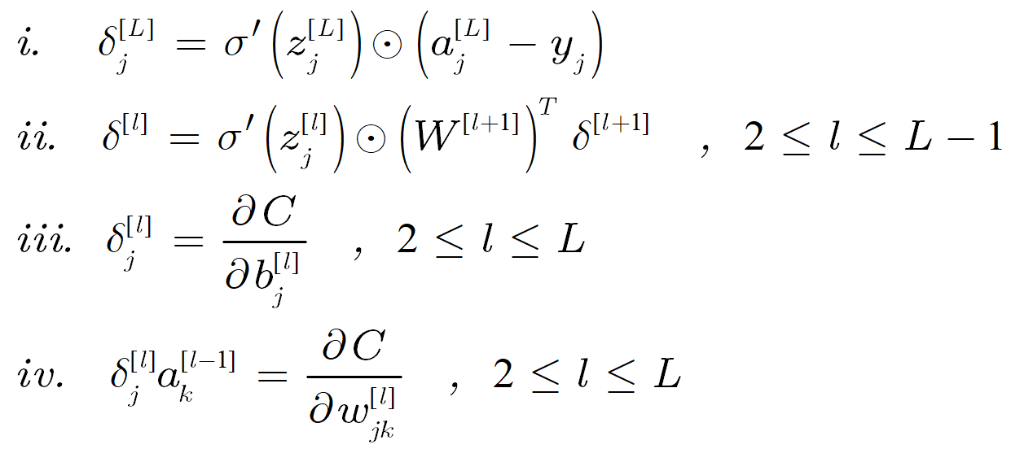
We define the Hadamard product as follows:
The Hadamard product is formed by pairwise multiplication of the corresponding components.
The four equations behind BP:

Slide 30
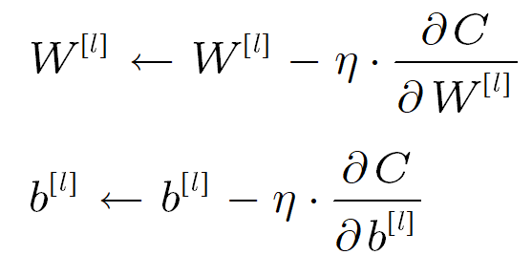

As we mentioned, Backpropagation is a method to update the weights in the neural network by taking into account the actual output and the desired output. We work on each layer separately instead of all weights together.
The derivative with respect to each weight and bias is computed using the chain rule, from the last layer backwards.
Then, by using this method, we get:
η is the step size

Slide 31
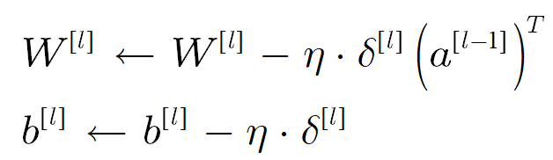
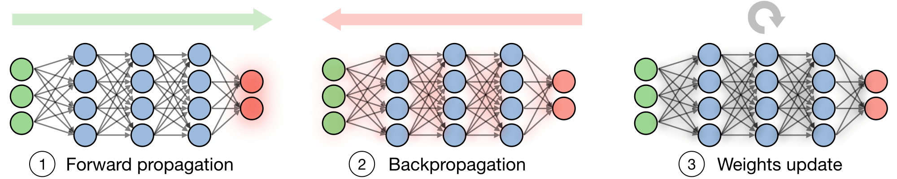
By equations (iii) and (iv) we can see:

Slide 32
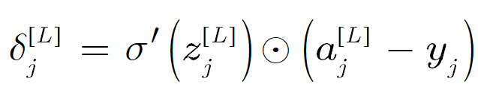
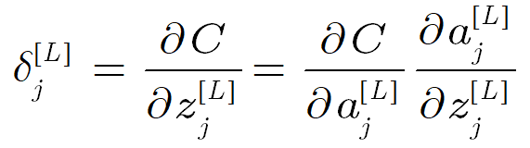
Equation #1: An equation for the error in the output layer
The first term on the right, measures how fast the activation function σ is changing at z. The second term on the right, just measures how fast the cost is changing as a function of the output activation. If, for example, the cost function doesn't depend much on a particular output neuron, j, then δ will be small, which is what we expect.
Proof:
From definition of δ and a:

Slide 33
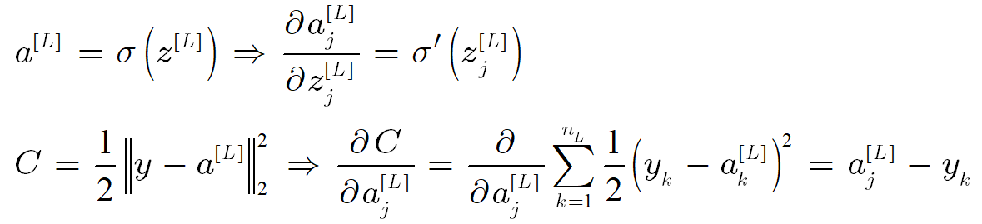
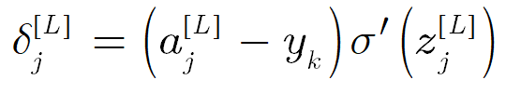
So, we can get:
This gives:

Slide 34

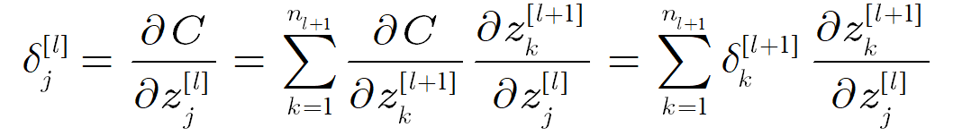
Equation #2: The error in terms of the error in the next layer
By combining equation 2 with equation 1 we can compute the error δ for any layer in the network. We start by using equation 1 to compute δ in layer L, then apply equation 2 to compute δ in layer L-1, and so on, all the way back through the network.
Proof:
From the definition of z we know:

Slide 35
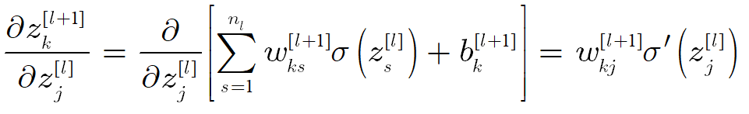
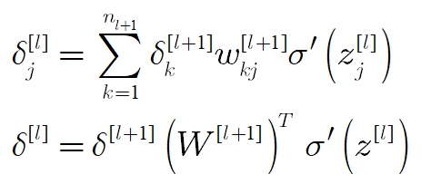
So, we get:
This gives:

Slide 36
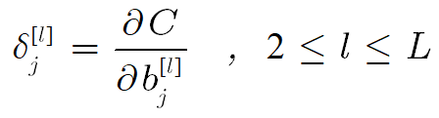


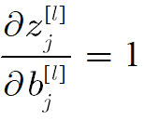
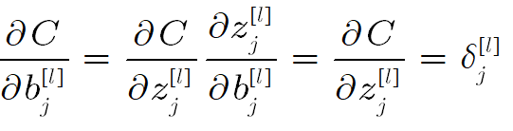
Equation #3: The rate of change of the cost with respect the bias
the error δ is exactly equal to the rate of change ∂C/∂b. we have already know how to compute δ by equations 1 and 2.
Proof:
We know that:
Since does not depend on , then:

Slide 37
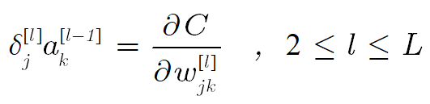
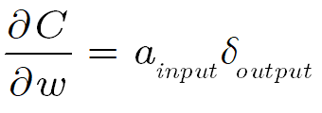


Equation #4: The rate of change of the cost with respect to the weights
The equation can be rewritten in a less index-heavy notation as:
We can see that when the activation is small, ,the gradient term ∂C/∂w will also tend to be small. In this case, we'll say the weight learns slowly, meaning that it's not changing much during gradient descent. In other words, one consequence of equation 4 is that weights output from low-activation neurons learn slowly.

Slide 38
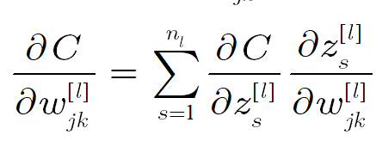
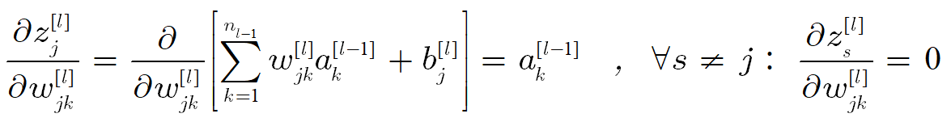
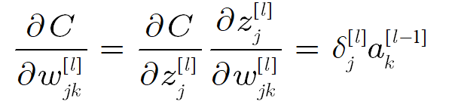
Proof:
That is, the above two equations follow because the jth neuron at layer l uses the weights from only the jth row of W in layer l. Hence:

Slide 39
BP - Advantages vs. Disadvantages
Most of the advantages of Backpropagation are:
➢ Backpropagation is fast, simple and easy to program.
➢ Simplifies the network structure by elements of the weighted links that have the
least effect on the trained network.
➢ It helps to assess the impact that a given input variable has on a network output.
Disadvantages of using Backpropagation are:
➢ The actual performance of backpropagation on a specific problem is dependent
on the input data.
➢ Backpropagation can be sensitive to noisy data.

Slide 40
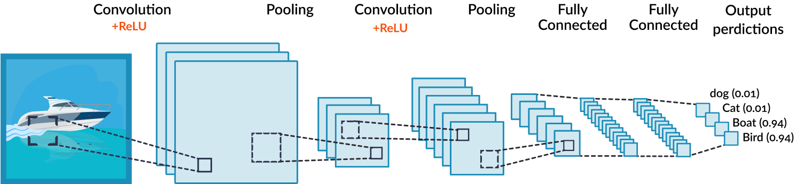
Convolutional Neural Network
CNN’s are a specific kind of neural networks useful for processing data that has a known grid-like topology. For example, time series data (represented as a 1D grid) or an image data (2D grid).
CNN’s use a convolution operation instead of general matrix multiplication in one or more of it’s layers.

Slide 41
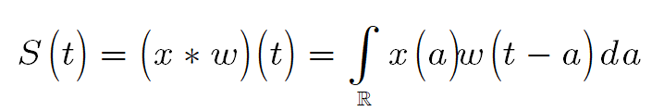

The convolution operation
In general, the convolution is an operation between two functions, defined as:
A discrete convolution is defined as:
In neural net applications, the input is usually a multidimensional array of data, and the kernel is a multidimensional array of parameters. Because these functions are discrete, we usually assume that they are zero everywhere except for a finite set of points, where we store the data. That means that in practice we can sum over a finite number of array elements.

Slide 42
We can also apply the convolution over more than one axis at a time. For example, if we have a 2D image I as an input and a 2D kernel K, the convolution would be:
Because the convolution is commutative, we can write it as:
In neural networks we usually implement a related function called cross-correlation, which is the same as convolution but without flipping the kernel.

Slide 43
The convolution leverages three important ideas that can help improve our system.
Sparse interactions
Parameter sharing
Equivariant representation

Slide 44
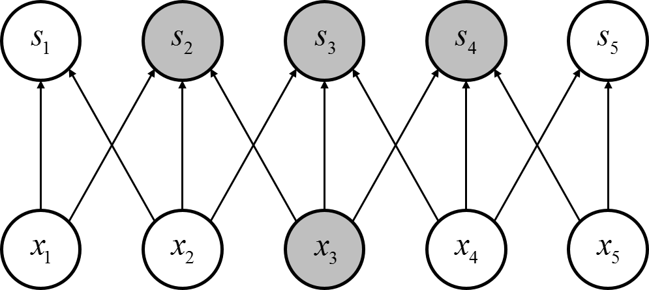
Sparse interactions
Traditional neural network layers (fully connected layers) use a matrix multiplication to describe the interaction between each input unit and each output unit. Meaning, each output unit interacts with every input unit.
A convolution layer, on the other hand, has sparse interactions. This is the result of having a kernel that is smaller than the input. Each output unit is connected to a small region of the input. For example, if we have a 3x3 kernel, each output unit will be connected to 9 input units.

Slide 45
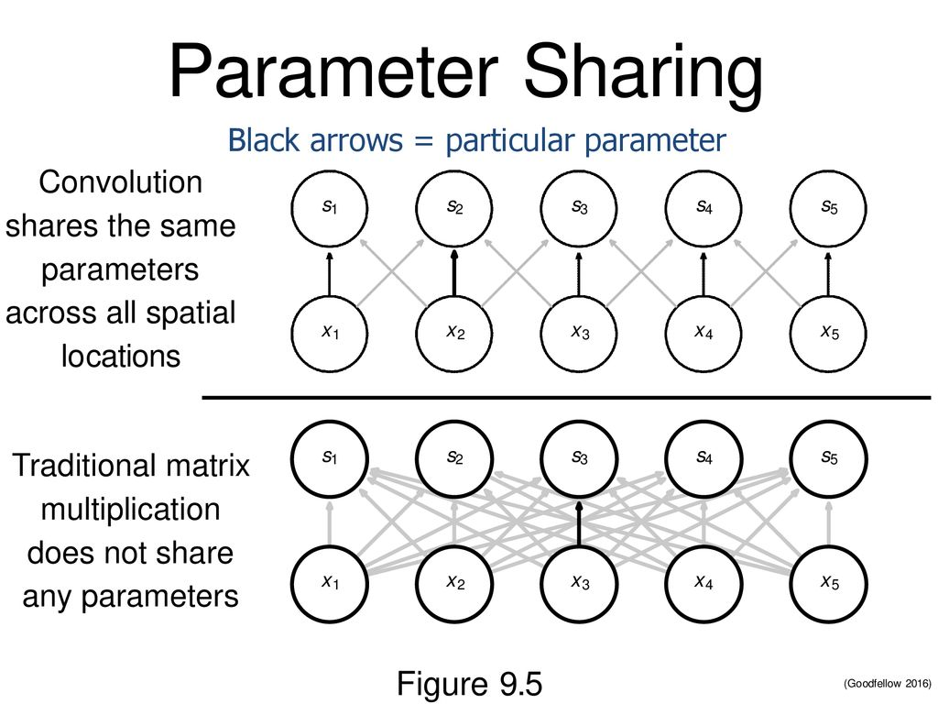
Parameter sharing
In a fully connected layer, each element of the weight matrix is used only once when computing the output of the layer.
In a convolution layer, each element of the kernel is used at every position of the input (except maybe the boundaries).
Parameter sharing makes convolution much more efficient in terms of memory requirements than matrix multiplication.

Slide 46
Equivariant representation
A convolution is also equivariant to translation.
For a function to be equivatiant, it means that if the input is shifted, the output is shifted in the same way.
For example, when processing time series data, the convolution produces a sort of timeline that shows where different features appear in the input. If we move an event later in time, the same representation of it will appear in the output, just later in time.

Slide 47
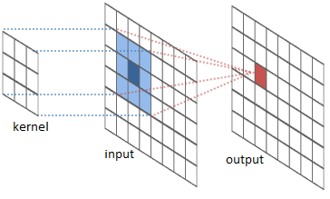
The convolution is achieved by passing a kernel over the input and computing the corresponding dot product at each region.

Slide 48
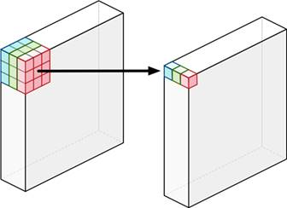
As an example, we will consider a 32x32x3 image and a 5x5x3 kernel.
For each region, the computation is equivalent to computing a 5x5x3=75 dimensional dot product.
Therefore, if we use only one kernel, the output will have a depth of one. For k kernels, the output will have a depth of k.

Slide 49
Regarding the width and height of the output, because of the dimensions of the kernel, the output will be smaller than the input.
In our example, a 32x32x3 image and a 5x5x3 kernel with stride 1, the output will be 28x28x1
To attend this issue, we usually add zero padding to the image.
If we wish to preserve the original size, we can use zero padding of (F-1)/2 with a stride of 1, where F is the size of the kernel (FxF)

Slide 50


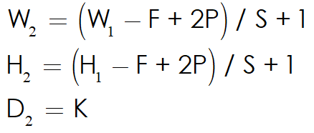
Summary of the dimension aspect of convolution
Input:
K - number of filters
F - size of filters (FxF)
S - the stride
P - the amount of padding
Output:

Slide 51
Pooling
A typical convolution layer consists of three stages:
Convolution
Non - linear activation function
Pooling function
A pooling function replaces the output of a certain location with a summary statistic of the nearby outputs. One example is max pooling. It takes the max value of a rectangular neighborhood.

Slide 52
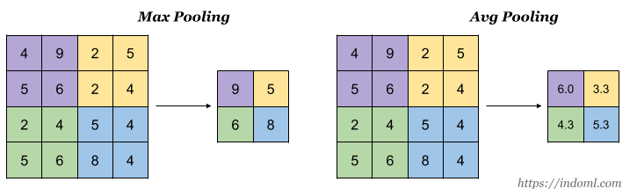

Other examples of pooling are:
Average pooling
norm of neighborhood
Weighted average based on distance from center.
Pooling helps make the representation become invariant to small translations of the input.
Invariance to local translation is very useful if we care more about whether some feature is present, rather than exactly where it is.

Slide 53
Recurrent neural network
An RNNs is essentially a fully connected neural network that contains a refactoring of some of its layers into a loop. That loop is typically an iteration over the addition or concatenation of two inputs, a matrix multiplication and a nonlinear function.
The following tasks are those RNNs perform well:
➢ speech recognition
➢ Machine translation
➢ Name entity recognition
➢ Word prediction
➢ Music generation

Slide 54
Other tasks that RNNs are effective at solving are time series predictions or other sequence predictions that aren’t image or tabular based.
RNNs effectively have an internal memory that allows the previous inputs to affect the subsequent predictions. It’s much easier to predict the next word in a sentence with more accuracy, if you know what the previous words were.
For example, the swift key keyboard software uses RNNs to predict what you are typing.
The Recurrent Neural Network consists of multiple fixed activation function units, one for each time step. Each unit has an internal state which is called the hidden state of the unit. This hidden state signifies the past knowledge that the network currently holds at a given time step.

Slide 55
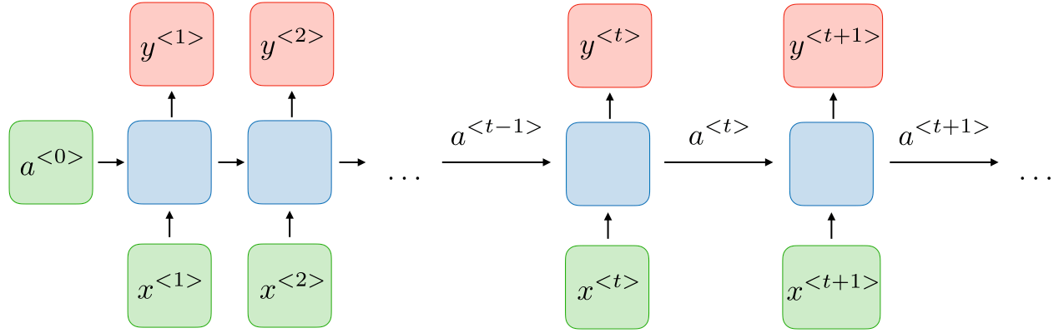
This hidden state is updated at every time step to signify the change in the knowledge of the network about the past.
The RNNs are typically as follows:

Slide 56


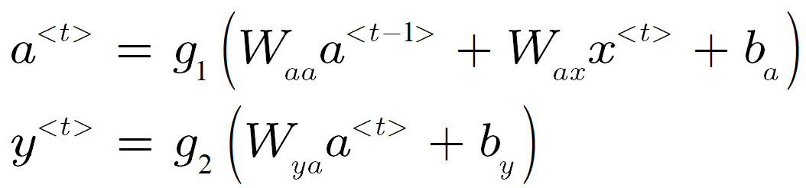



For each timestep t, the activation and the output are defined as follows:
Where usually we define to be a vector of zeros, but it can have other values also. are coefficients that are shared temporally and
are activation functions.
we denote the hidden state and the input at time step t respectively as: .

Slide 57
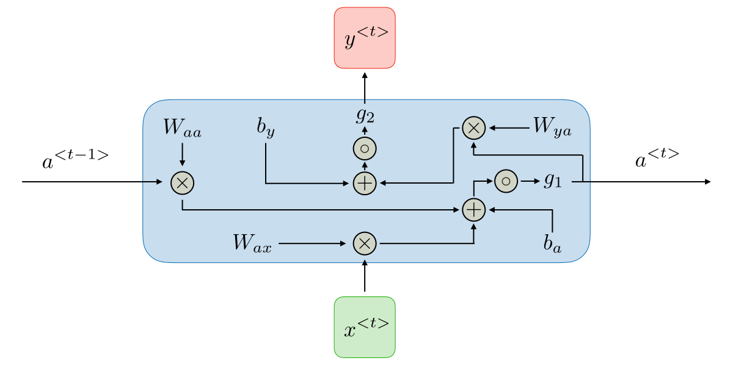
Visualisation of the model:
The most common activation functions used in RNN modules are sigmoid, hyperbolic tangent and ReLU.

Slide 58


Loss Function
The loss function for RNN of all-time steps is based on the loss at every time step. When we begin analyzing our input x to our desired output y throughout all the hidden part h one step at a time, we can define a loss function to explain the errors between output value and our target value as described here:
where the output state one step at a time.
The function basically sums up every lost item t of each update step so far. This is a generic function l, because this function will be based on the specific problem. (for example: MSE-mean square error, CEL-cross entropy loss etc.)

Slide 59
Vanishing/Exploding gradient
The Back-Propagation process can lead to the following issues.
Vanishing (tend to zero) or Exploding (tend to infinity) gradient is a problem well known in most neural networks as well in RNNs. The reason for this event is that multiplicative gradient could be either growing too much or shrinking too much.
When we have a significantly high number of layers it could cause a problem because it is difficult to capture the dependencies which occur throughout the multiplication level. On the one hand, if the matrix values consists of very large numbers , it will cause the gradient to grow more and more and eventually tends to converge in the broader sense. On the other hand, when there are many multiplications with matrices with very small values, it will cause the opposite effect and will converge to the zero matrix. A solution to this problem is long short-term memory units (referred to as LSTM) which can handle this problem.

Slide 60
Long Short Term Memory
An RNN has short term memory. When used in combination with Long Short Term Memory (LSTM) Gates, the network can have long term memory.
Instead of the recurring section of an RNN, an LTSM is a small neural network consisting of four neural network layers.
These are the recurring layer from the RNN with three networks acting as gates:
1. An Input gate, this controls the information input at each time step.
2. An Output gate, this controls how much information is outputted to the next
cell or upward layer.
3. A Forget gate, this controls how much data to lose at each time step.

Slide 61
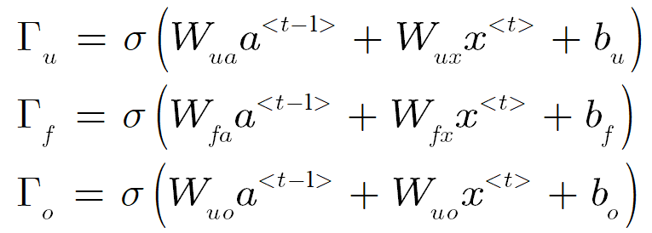

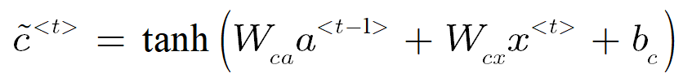
As part of the gates computation, the sigmoid function compress the values of these vectors between 0 and 1, and by multiplying them elementwise with another vector you define how much of that other vector you want to “let through”.
Next, we need a candidate memory cell which has a similar computation as the previously mentioned gates but instead uses a tanh activation function to have an output between -1 to 1.

Slide 62





We introduce old memory content: ,which together with the introduced gates controls how much of the old memory content we want to preserve to get to the new memory content.
Where is the Hadamard product.
The last step is to introduce the computation for the hidden states .

Slide 63

Visualisation of the model:

Slide 64

Gated Recurrent Unit
One of the lesser known, but equally effective variations, to solve the Vanishing-Exploding gradients problem is the Gated Recurrent Unit Network (GRU).
Unlike LSTM, the update gate acts as a forget and input gate. The coupling of these two gates performs a similar function as the three gates forget, input and output in an LSTM.
Compared to an LSTM, a GRU has a merged cell state and hidden state, whereas in an LSTM these are separate.

Slide 65


Now we define:
Visualisation:

Slide 66



Types of RNNs
We denote to be the input size and output size, respectively.
➢ Many to one,
Example: Sentiment classification

Slide 67


➢ One to many,
Example: Music generation/Word prediction

Slide 68


➢ Many to many,
Example: Name entity recognition

Slide 69


➢ Many to many,
Example: Machine translation

Slide 70



Deep Recurrent Neural Networks
Deep Recurrent Neural Networks (DRNNs) are in theory a really easy concept.
To construct a deep RNN with k hidden layers we simply stack ordinary RNNs of any type on top of each other. Each hidden state is passed to the next time step of the current layer as well as the current time step of the next layer
.
For the first layer we compute the hidden state as proposed in the previous models while for the subsequent layer we use the hidden state from the previous layer is treated as input.
The output is then computed where we only use the hidden state of layer k.

Slide 71

Visualisation of the model:

Slide 72
Bidirectional Recurrent Neural Networks
Sometimes it’s not just about learning from the past to predict the future, but we also need to look into the future to fix the past.
In speech recognition and handwriting recognition tasks, where there could be considerable ambiguity given just one part of the input, we often need to know what’s coming next to better understand the context and detect the present.
This does introduce the obvious challenge of how much into the future we need to look into, because if we have to wait to see all inputs then the entire operation will become costly. In addition, in cases like speech recognition, waiting till an entire sentence is spoken might make for a less compelling use case.

Slide 73

For example:
"He said, Teddy bears are on sale"
"He said, Teddy Roosevelt was a great president"
Visualisation of the model:

Slide 74
Summary RNNs
Advantages:
➢ An RNN remembers each and every information through time. It is useful in time
series prediction only because of the feature to remember previous inputs as well.
This is called Long Short Term Memory.
➢ Weights are shared across time.
➢ Possibility of processing input of any length.
➢ It helps to assess the impact that a given input variable has on a network output.
Disadvantages:
➢ Gradient vanishing and exploding problems.
➢ Computation being slow.
➢ Difficulty of accessing information from a long time ago.

Slide 75

Autoencoders
An autoencoder is a unsupervised artificial neural network used for learning a lower-dimensional feature representation of unlabeled data.
The model consists of two parts: an encoder and a decoder.
In between the two, there is a hidden layer sometimes referred to as the code or the latent layer. The input and the output have the same dimension and the latent layer is of a lower dimension. This is called an undercomplete autoencoder.

Slide 76
With this design, we impose a bottleneck in the network which forces a compressed knowledge representation of the original input.
If the input features were each independent of one another, this compression and subsequent reconstruction would be a very difficult task. However, if some sort of structure exists in the data (ie. correlations between input features), this structure can be learned and consequently leveraged when forcing the input through the network's bottleneck.
A bottleneck constrains the amount of information that can traverse the full network, forcing a learned compression of the input data.

Slide 77

Visualisation of the model:

Slide 78


The idea is to represent the data with only its most important features, thus reducing its dimension. This is done by the encoder.
The decoder then, reconstructs the data from the compressed code, resulting in an approximation of the original output.
The network is trained by minimizing the reconstruction error, comparing the output to the input.
Encoder:
Decoder:
Loss function:

Slide 79

Because neural networks are capable of learning nonlinear relationships, this can be thought of as a more powerful (nonlinear) generalization of PCA.
Whereas PCA attempts to discover a lower dimensional
hyperplane which describes the original data,
autoencoders are capable of learning
non-linear manifolds.

Slide 80

In some models, the latent layer has the same (or a higher) number of nodes as the input and the output, meaning, there is no bottleneck. In this case, the network could easily learn the “Identity function” and thus become useless.
In the image below, we can see that the network simply memorizes the input and passes it forward.
There are different ways for
dealing with this problem.

Slide 81

Sparse autoencoders
Sparse autoencoders offer us an alternative method for introducing an information bottleneck without requiring a reduction in the number of nodes at our hidden layers. Rather, we'll construct our loss function such that we penalize activations within a layer.
There are different ways by which we can impose this sparsity constraint. They involve measuring the hidden layer activations for each training batch and adding some term to the loss function in order to penalize excessive activations.
For example, L1 regularization:

Slide 82
Denoising Autoencoders
Differently from sparse autoencoders or undercomplete autoencoders that constrain representation, Denoising autoencoders try to achieve a good representation by changing the reconstruction criterion.
The idea is to slightly corrupt the input data but still maintain the uncorrupted data as our target output. Then, we feed forward the information normally, but calculate the loss function by comparing the output to the uncorrupted data.
This way, we create a latent representation of the uncorrupted data.
This restrict the network from learning the identity function (because we compare the output to the uncorrupted data).
This model is useful for cleaning and restoring noisy data.

Slide 83



Contractive autoencoder
Contractive autoencoder adds an explicit regularizer to their loss function that forces the model to learn a function that is robust to slight variations of input values.
For m observations and n hidden layer nodes, we can calculate these values as follows.

Slide 84

We can explicitly train our model, requiring that the derivative of the hidden layer activations are small with respect to the input. In other words, for small changes to the input, we should still maintain a very similar encoded state.
The name contractive comes from the fact that the Contractive autoencoder is encouraged to map a neighborhood of input points to a smaller neighborhood of output points.

Slide 85
ANN Advantages
ANN has the ability to work with incomplete knowledge. After we finish the training process, our data may predict a 'good' output despite the incomplete information. The total loss of performance depends on the significance of the missing data.
The network can to be fault tolerant. If one or more cells of the network are corrupted, it will not prevent it from generating an output.
In addition, ANN has a distributed memory. The network's success is a derivative of the examples that are given to the network. Furthermore, ANN has the capability of parallel processing. The network has enough numerical strength, so that he can perform more than one process at the same time.
Finally, ANN has the ability to make machine learning. The network can learn from examples and make a decision based on similar data.

Slide 86
The End

